Slide 1
SENTIMENT ANALYSIS
{LUKE FAVOUR BISOLA}
{MR OLUWOLE,MR BLESSING AND MR ISAAC}
SENTIMENT ANALYSIS ON PRODUCT REVIEW
{27-JUNE-2025}

Slide 2
Study Background
Sentiment analysis is a natural language processing (NLP) technique used to determine whether data is positive, negative, or neutral.
Many e-commerce platforms depend on customer reviews to improve their products and services.
Understanding product sentiment helps businesses make data-driven decisions.

Slide 3
Study Background
Used a Flipkart Dataset , one of India’s biggest e-commerce platforms, receives thousands of product reviews.
Manual analysis of such reviews is time-consuming and inefficient.
Automating this process with machine learning enables faster insight into customer satisfaction.

Slide 4
Problem Statement
Businesses often ignore or fail to analyze product reviews due to volume and lack of tools.
This leads to missed opportunities to improve customer experience.
Poor analysis of feedback can cause customer churn and revenue loss.

Slide 5
Problem Statement
The goal is to develop a model that classifies product reviews as positive, negative, or neutral.
This will help the business act quickly on customer concerns or praise

Slide 6
AIM AND OBJECTIVE
To develop a sentiment analysis model that can classify customer reviews of products as positive, neutral, or negative.
To assist businesses in understanding customer feedback automatically and efficiently.
To provide a tool that can enhance product quality and customer satisfaction through feedback interpretation.

Slide 7
OBJECTIVE
. To collect and preprocess product review data from Flipkart Dataset (via Kaggle).
To create a labeled sentiment column based on the rating score.
To explore the data (EDA), Clean text Data and identify key trends or patterns.
To handle class imbalance using SMOTE AND CLASS WEIGHT to ensure fair model training.

Slide 8
OBJECTIVE
To use TF-IDF Vectorization and Enconding label to covert text to numeric form
To train and evaluate machine learning models (Logistic Regression and Naive Bayes).
To save and deploy the best-performing model for real-time use.
To measure model performance using confusion matrix and classification report.

Slide 9
Materials and Methods
Dataset: Flipkart product review data sourced from Kaggle.
Features include: Product name, price, rating, and customer reviews.
Target variable (sentiment): Created using rating (positive, neutral, negative).
Data preprocessing: Cleaning, removing duplicates, handling missing values.

Slide 10
Materials and Methods
Class imbalance handled using SMOTE (Synthetic Minority Over-sampling Technique)AND CLASS WEIGHT from logistic regression
Models used: Logistic Regression and Naïve Bayes
Manually tuned my model using Random forest classifer
Evaluation metrics: Confusion matrix, classification report, and accuracy.

Slide 11
RESULTS
MODEL USED
Logistic Regression
Naive Bayes
Random Forest (manual tuning)
I focused on the F1-scores for each class (Negative, Neutral, Positive), Because of dataset is imbalanced.

Slide 12
model summary
For Logistic Regression, I got strong F1-scores in the positive and negative classes. The negative class had a precision of 0.98, recall of 0.91, and F1-score of 0.94. The positive class had a precision of 0.99, recall of 0.94, and F1-score of 0.96. However, the neutral class showed imbalance ,even though the recall was high at 0.95, the precision was low at 0.66, leading to an F1-score of only 0.75. This showed that the model struggled to correctly classify neutral reviews, likely due to class imbalance..

Slide 13
model summary 2
Although I used class weighting (class_weight='balanced') and smote techniques, the neutral class still lagged behind. I then tried Naive Bayes, but it further reduced the neutral F1-score to 0.72, performing worse than Logistic Regression. The neutral class remained a challenge here as well.

Slide 14
model summary 3
To improve performance, I used manual tuning with Random Forest. This gave me a more balanced result across all classes. The neutral F1-score improved significantly to 0.81, while the negative F1-score was 0.91 and the positive remained high at 0.96. This showed that Random Forest with manual tuning was more capable of handling the class imbalance and gave better overall sentiment classification..

Slide 15
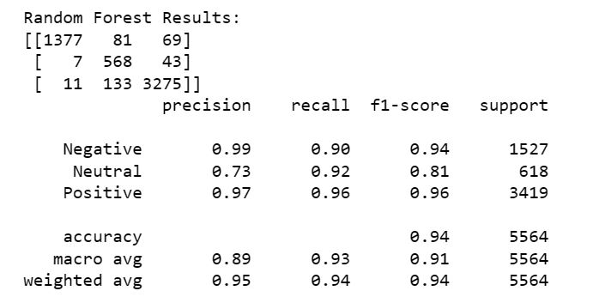
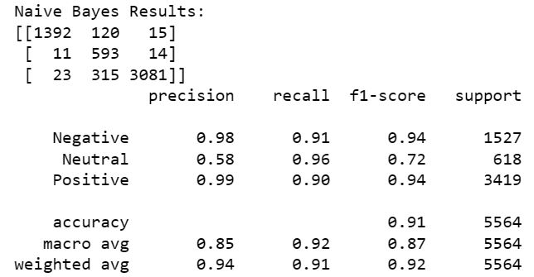
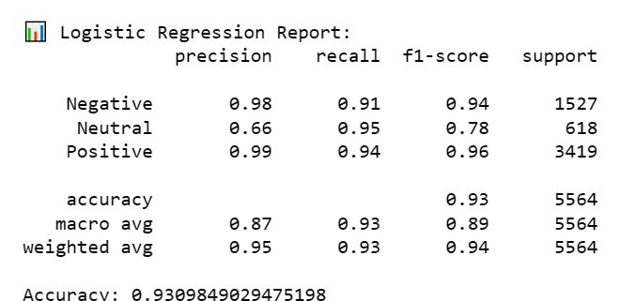

Slide 16
CONCLUSION
Logistic Regression and Naive Bayes both performed well for the positive and negative classes but struggled with the neutral class due to class imbalance. Random Forest, after manual tuning, gave the most balanced results, significantly improving the neutral F1-score. Therefore, Random Forest is the most effective model for this sentiment classification task.

Slide 17
Thank You for Listening

